Slide 1
Home Visits
Take time to understand your child’s story.
Conductor Master Copy

Slide 2
FEEL
(Hot Spots)
See a child in isolation of their home and family environment
teachers often make assumptions about a child’s parenting
formal school settings have very less scope for informal dialogue
Teachers not aware of student socio-emotional situation at home
Teachers teach based on limited understanding of students
(Bright Spots)
Parents & teachers want happiness and success for their children
Child feels emotionally secure knowing parents and teachers are working together for his good.

Slide 3
IMAGINE
Home visits From Labeling to Enabling
Understanding a child’s complete story by taking time to empathize with parents & getting to know child’s home environment.

Slide 4
Advantages
Bridges the gap between home and school.
Safe space for parents to share sensitive information
Understanding child’s living environment.
Understand activities and behavior of child & family members.
Opportunity for teachers and parents to talk about their interests.
Teachers design lessons mindful of child's family life.
KS1 Student response for the relevance of Home Visits

Slide 5
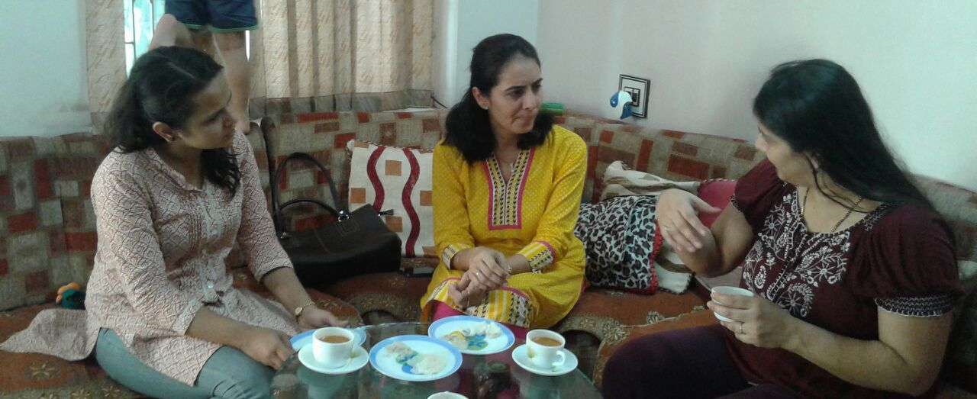
Video – What a home visit looks like //Look at the Video in the resources//
DO
Pre- K Home Visit

Slide 6
Overview
VISITS DONE FOR?
KS1 Pre –K K1 – Grade 2 KS2 KS3 (specially incoming grade 8)
All new students
Children with Inclusivity Program
VISITS DONE BY? (as needed):
Class teachers
School Leaders
Special
DONE WHEN?
Beginning of the year
PreK: Before start of the year
Remaining Grades: After the first month of academic year
Beginning of term 2 (for inclusivity program – RTE, Special Needs)
STEPS FOR HOME VISITS:
Preparation
Home visit
Post visit reflection

Slide 7
Steps for Preparation: [HOW TO?]
Schedule your home visits:
Make a tentative area-wise timeline for home visits, keeping the following points in mind:
Duration of home visits (Rec. 45 mins.)
Organize visits day wise (Rec. number of visits per day, travel time, transportation, etc)
Send form to collect basic details
Pre-Home Visit form is sent to collect information basic information about child’s and family’s routines, health and academic concerns, and other details that will help
Finalize visits with parents:
The Form intimates parents the date and time scheduled for home visits well in advance (Rec. at least a week before)
Be open to changes in slots and days upon parents’ request.
3. Readiness for home visits
Demo home visits with your colleagues, just to ensure you brush up your soft skills.
Ready copies of Home Visit Forms that you will fill in during your home visits.
Notes:
Look only at the bold words

Slide 8
During a Home Visit
CHECKLIST FOR HOME VISITS:
a friendly smile
Home visit form
Suitably attired
Camera (take photos)
Contact details
HOME VISIT FORM:
need not fill all information
Be open to information critical for a child’s socio-emotional wellbeing.
THINGS TO REMEMBER:
Listen, respond, ask (in that order)
Greet family in manner that is comfortable to them
Hold a conversation, not your form.
Engage with your child and family, see your child’s personal space from his eyes.
Honor time, their & yours.
Inform when late
Notes:
Key words for presentation are bold.

Slide 9
Demo with Conductor
Lets try it out!

Slide 10
Post Home Visit
Complete Home Visit form
(Could be done in transit between visits)
key insights and observations
Understanding unique to child
Discuss and collate overall insights about class by discussing with:
Last year’s class teacher
School Leader
Post Home Visit Reflection
On your teaching style & classroom management.
Notes about specific needs of some children

Slide 11
Important Considerations during Home Visits
For all Key Stages:
Be mindful of allergies, sensitivity to certain chemicals, sounds and images.
Past physical injuries or conditions.
Habits that are harmful or disconcerting
Any complexes or phobia.
Pre-K:
Done before the starting of academic year, so children build a sense of familiarity with teachers.
Get a toy/any belonging of the student to aide settling in the first week.
Key Stage 2 & 3:
Socio-emotional behaviors or habits that seem harmful, worrisome or drastically different

Slide 12
Riverside Formats for Home Visits:
Pre-Home Visit form
Home Visit form
Post Home Visit Grade Reflection
Handouts:
Checklist: During Home Visit (Useful for Demo with Conductor)
Sample Home Visit form (Pending)
Sample Home Visit Schedule
Home Works Logic Model
Giveaways (online)
Home Visits: Reaching Beyond the Classroom (Edutopia)
The Power Of Home Visits (nprEd) – Listen to the article
Parent-Teacher Home Visits (Edutopia)
Home Visits to School Transformation (NeaToday)

Slide 13
Reflection & Feedback time

